Slide 1
Costco Supply Chain Research
By: Jayan Sesha, Ethan Wan, Adam Giljic, Matt Glasberg, and Mihir Chinta

Slide 2
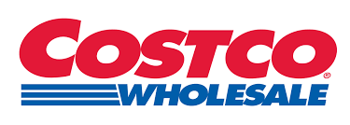
Company Overview
Jayan
Founded in 1983 and headquartered in Issaquah, Washington, Costco Wholesale operates membership-based warehouse clubs that sell products in bulk at low prices to maximize value for members.
Its product offerings include groceries, electronics, furniture, clothing, and home goods, along with its popular private label brand Kirkland Signature known for premium quality at lower prices.
Costco also provides a wide range of services such as gas stations, pharmacies, optical centers, tire service, insurance programs, food courts, and online shopping through its e-commerce platform.
The company operates over 914 warehouses worldwide, employing more than 333,000 people and serving about 137 million members globally as of September 2025.
While most warehouses are located in North America (U.S., Canada, and Mexico), Costco also has a strong international footprint across markets like Japan, South Korea, the UK, Australia, Spain, Taiwan, France, Sweden, and China.

Slide 3
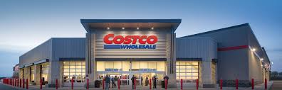
Vision, Mission, & Strategy
Jayan
Mission: Costco’s mission is to continually provide its members with quality goods and services at the lowest possible prices, ensuring value and trust through efficiency and ethical business practices.
Vision: The company aims to be the most efficient buying and operating platform in the world, giving members access to unmatched savings through operational excellence and large-scale purchasing power.
Some of Costco’s key strategies are:
  Cost leadership, maintaining low markups and high sales volume in order to maintain profit and price.
  Long-term partnerships with suppliers are central to Costco’s sourcing approach, ensuring consistent quality, competitive pricing, and sustainable procurement across global markets.
  Efficient warehouse layouts and logistics systems, reducing handling costs, supporting its low-price model.
  Expansion into international markets, focusing on high-demand regions to increase customer base.
  Investing heavily into technology and sustainability, improving inventory systems, energy efficiency, and ethical practices to support long-term growth and community trust.

Slide 4

Strengths:
Its main source of revenue is from membership dues which
proves a good brand relationship with customers
Is able to have an advertising budget of $0 due to positive word-of-mouth
Has a membership tier list that encourages luxury customers to pay for “Executive Status”: Gold Membership $65, Executive $130 - offers discounts along with 2% cashback on travel and other Costco services
Weaknesses:
Stock price is high in comparison to its P/E (price to earning) ratio
Limited product selection which can deter customers who prefer variety
Reliance on North American markets instead of expanding to international
Matt

Slide 5
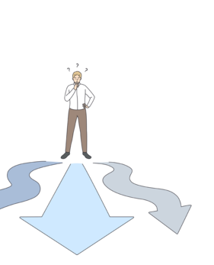
Matt
Opportunities:
International markets haven’t been fully explored, this leaves revenue on the table for the company to profit on. Even further by adapting to local cultural trends
Promote membership benefits by ensuring the promise of high quality products at best rate
To achieve better results with niece customer tastes costco can embrace more online shopping options along with more store formats to attract broader customer ranges
Threats:
Thin profit margins which make leave it vulnerable to rising costs
Where Costco’s strength in physical stores is their internet market is untouched which leaves online shoppers not using their brand and turns away customers who need flexible shopping options
Rising labor costs mixed with supply chain issues will cause productivity to quickly decline

Slide 6
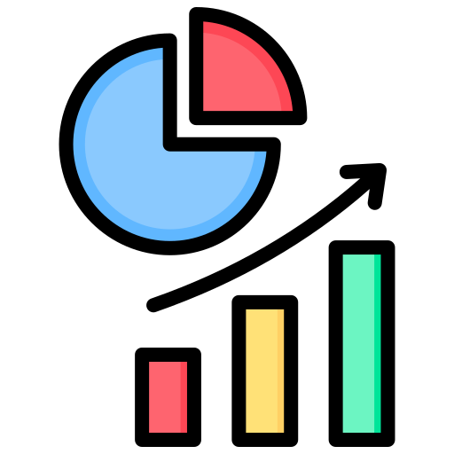
Competitive Position
Is the dominant entity in warehouse club industry having significant market share
Its membership-based business model leads to strong customer loyalty
With profits from memberships Costco can afford to give low prices on products which lead to higher sales volume
Costco’s model is built on offering high quality products in bulk at discounted prices for its customers
Is the leader in warehouse club market having 60-70%
Matt
Market Share
Holds 60% of US warehouse club market
Smaller than Amazon or Walmart
8.4% of US grocery dollars
Net sales of $249.6 billion
Walmart
Holds 21% of US grocery dollars
Largest retailer in the world
Consistently in top position of US grocery market share
Sam’s Club
Holds 31% of US warehouse club market
Second-largest club store in the US
Had net sales of $90.2 billion

Slide 7

5 Year Sales & Profitability Trends/Future Projections
 | 2020 | 2024 | % Increase over 5 Years
Net Sales | $163.22 billion | $249.67 billion | 53%
Net Income | $4 billion | $7.4 billion | 85%
Memberships | 105.5 million | 137 million | 30%
Given how Costco is structured they are projected to experience a steady growth over the next few years.
Through increased memberships, a continued effort to expand globally, and low cost operations Costco is positioned well.
Over the next 5 years, Costco is expected to repay 2.58 billion in debt which is manageable given their growth and current cash flows.
Adam

Slide 8
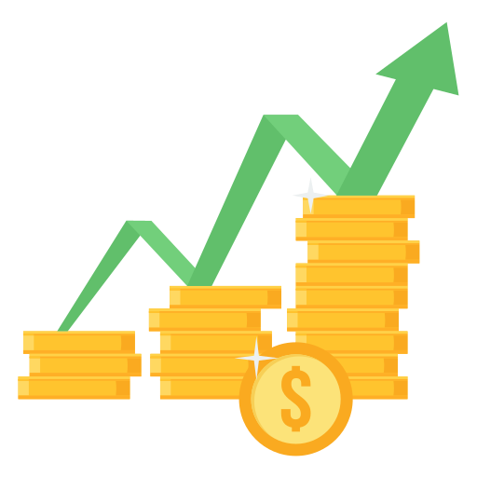
Key Financial Metrics
Costco has experienced a growth in revenue of 53% over the past 5 years with their net income increasing by over 17% in the last year.
Costco’s most recent ROE was about 31% which is an increase in almost 14% from the year prior, indicating that shareholder returns are strong.
The return on capital employed sits at about 27% which when compared to the average of 11% Costco is doing exceptionally well.
Costco’s inventory turnover was about 12 in the most recent report showing their ability to not only get rid of their products quickly but also efficiently.
Adam

Slide 9
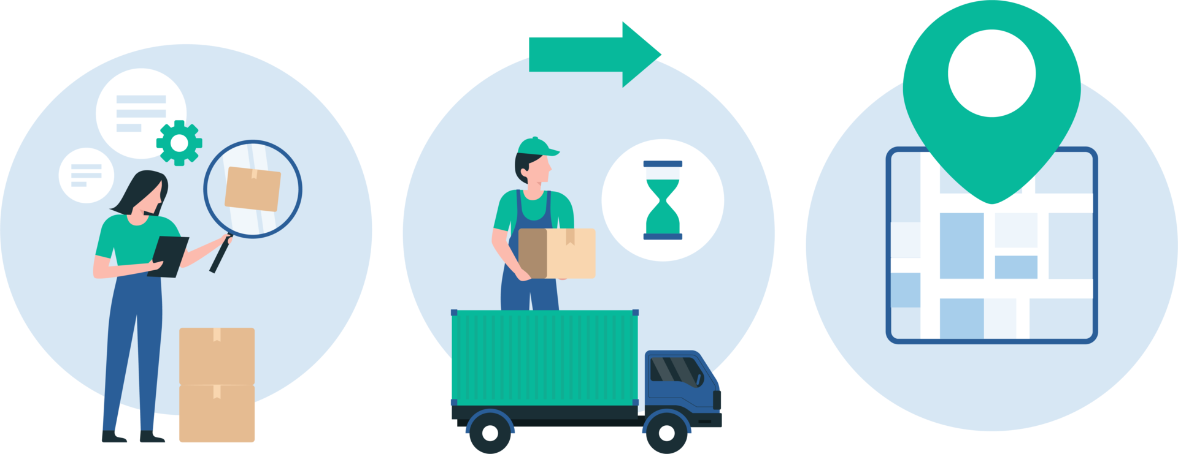
Overview of Costco’s Supply Chain Network
Costco currently operates over 900 warehouses worldwide with over 30% being outside the U.S. in places like Japan and Canada.
Costco has a centralized buying and distributing model allowing them to work with their suppliers and ship products at low costs.
Costco has a variety of relationships with different supply sources, including brands like Kirkland Signature. If problems arise and a supplier becomes unavailable they immediately seek alternatives to ensure there’s product availability.
As a company Costco has less than 4,000 unique items for sale compared to other supermarkets who may carry 10 times as much. This allows for more efficiency, lower costs, and a simpler inventory making it an easier experience for customers.
Adam

Slide 10
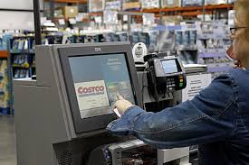
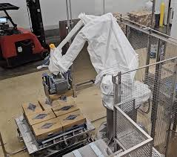
Technology & Advancements
Warehouse Advancements
Costco's has been consistently integrating new technology within its supply chain to optimize each step of the system
Automated Materials Handling systems via robotic case de-palletizing system
Costco's main focus when integrating technology is to reduce the average time spent by an employee on a task, allowing for their optimistic output estimates
Real time inventory tracking in warehouse
In- Store Advancements
Scan-and-pay Pilot program
Express checkout kiosks integrated with AI assistant
Let's Talk Numbers
Use of AI/ML to optimize inventory increased limited stock of 4,000 items
Higher Inventory turnover rate of 33 days from 2022
Mihir

Slide 11
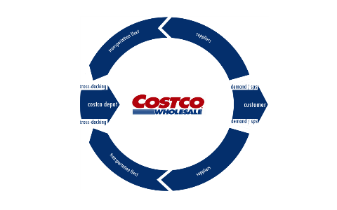
Costco’s Supply Chain Assessment
Costco’s membership warehouse business model has unique strengths, in its simple low number of SKUs (stock keeping units) compared to other supermarkets, high inventory turnover due to selling in bulk, and large profits due to membership fees.
  It also takes advantage of being a warehouse, acting both as a store and as storage simplifying their supply chain.
Costco utilizes a cross-docking system, where products are delivered directly to the end customer from a distribution docking terminal, in this case their warehouse.
  This means products are brought into a Costco depot, then to a truck delivering the goods to whatever warehouse ordered it.
Their simplicity allows for adaptability, shifting sourcing for Kirkland goods to local markets after President Trump’s tariffs, and diversifying their suppliers to reduce price spikes.
Despite massive constraints due to tariffs, Costco seemingly navigated the issue so far, and their strong logistics and simple business model is an exemplary supply chain system.
Ethan
Notes:
By Ethan Wan
Sources:
https://www.damotech.com/blog/costco-marketing-strategy-and-warehousing-approach
https://www.thomasnet.com/insights/costco-supply-chain/
https://www.ainvest.com/news/costco-competitive-resilience-high-tariff-environment-2508/
https://www.supplychainbrain.com/articles/41351-costco-wrestles-with-supply-chain-constraints-as-profits-fall-short#:~:text=Costco%20Wrestles%20with%20Supply%20Chain%20Constraints%20as%20Profits%20Fall%20Short,-Photo%3A%20iStock%20%2F%20slobo&text=Reported%20profits%20from%20big%2Dbox,uncertainties%20loom%20over%20the%20industry.
https://mobilecontent.costco.com/staging/resource/img/25w03130/3b_Transportation&Logistics_FY24.pdf

Slide 12
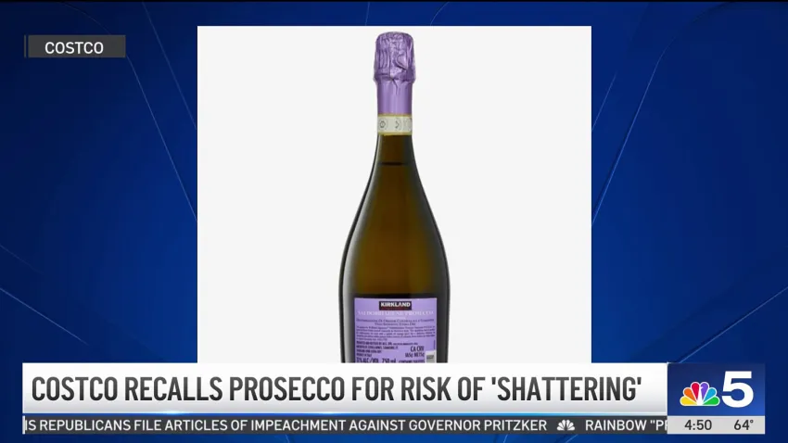
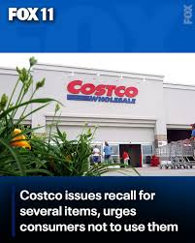
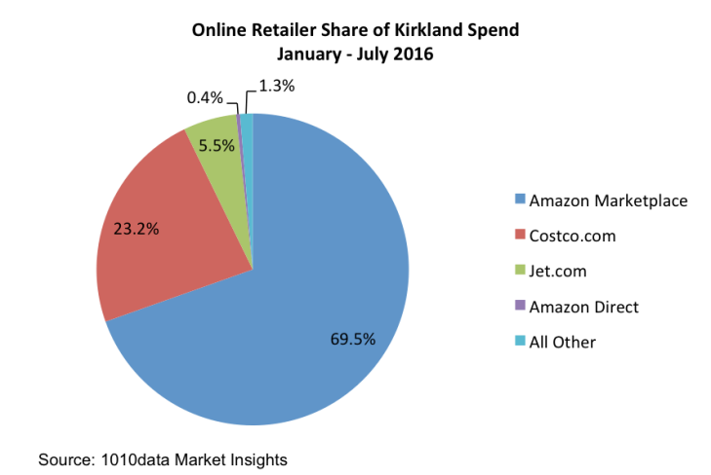
Key Issues
Despite Costco’s general success, there are still some issues that they must address:
Recalls and Supplier Risks: In recent years, Costco’s dependence on third party manufacturers can create quality oversight. 90% of Kirkland's products are outsourced creating both flexibility and major quality recalls. In recent years their salmon and egg products had signs of serious health risks showing gaps in supply quality control.
Weaker E-Commerce: Despite their growing online presence, there are still many reports of shipment and delivery delays, alongside poor communication with customers when orders are delayed.
Rising Costs from Tariffs and Freight: In response to the tariffs, Costco has been purchasing extra inventory in order to mitigate price spikes, however it adds costs for storage, spoilage, or demand for certain products decreasing overtime.
Ethan
Notes:
By Ethan Wan
Sources:
https://anthonysmoak.com/2017/08/06/costcos-underinvestment-in-technology-leaves-it-vulnerable-to-disruption/
https://www.businessinsider.com/costco-earnings-purchasing-extra-inventory-tariff-uncertainty-2025-3
https://www.ainvest.com/news/costco-recall-crisis-test-supply-chain-resilience-consumer-loyalty-2507/

Slide 13
Some Potential Improvements
Recall and Supplier Risks: Some solutions to these issues can be on-site inspections for goods with high risks of contamination like salmon and eggs and investing more into supplier training.This would cost more, but the investment would be negligible compared to the cost from multiple recalls disrupting sales and creating distrust in consumers. These solutions strengthen both customer trust, but also reinforce the prominent domestic suppliers relationship with Costco.
E-commerce Issues: Improving communication will come with time and proper training. Can take advantage of tiered memberships to monetize convenience i.e faster delivery in order to offset costs of delivering large items like furniture. Can also further advertise their partnerships with Instacart to drive sales for their perishables. This way the speed at which orders can be completed improves without major costs.
Rising Costs: Use Long-term contracts with freight companies in order to lock in rates to prevent potential issues from more volatile periods. Slowly increase membership fees to absorb costs and continue their competitive prices. And utilize advancements in AI to calculate predicted stock and buy to prevent risk, but not enough to overstock shelves. This will build upon Costco’s already resilient supply chain.
Ethan
Notes:
By Ethan Wan

